Slide 1

What Jo Did
Fourth Grade
Unit 2 Week 1

Slide 2
Words to Know
fouled
rim
hoop
speechless
jersey
swatted
marveled
unbelievable

Slide 3


fouled
hoop
jersey
marveled
rim
speechless
swatted
unbelievable
marveled
was filled with wonder; was astonished

Slide 4
fouled
hoop
jersey
marveled
rim
speechless
swatted
unbelievable
jersey
a shirt that is pulled over the head, made of soft, knitted cloth

Slide 5
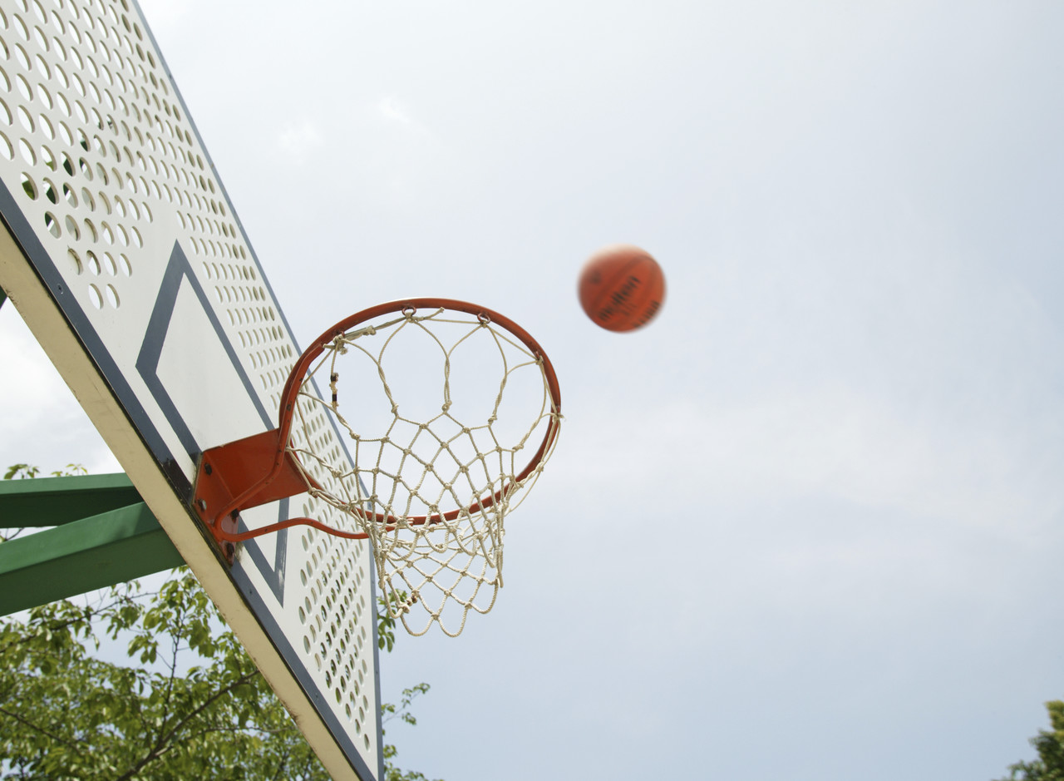
fouled
hoop
jersey
marveled
rim
speechless
swatted
unbelievable
hoop
a ring or round, flat band

Slide 6
fouled
hoop
jersey
marveled
rim
speechless
swatted
unbelievable
fouled
in sports, made an unfair play against

Slide 7
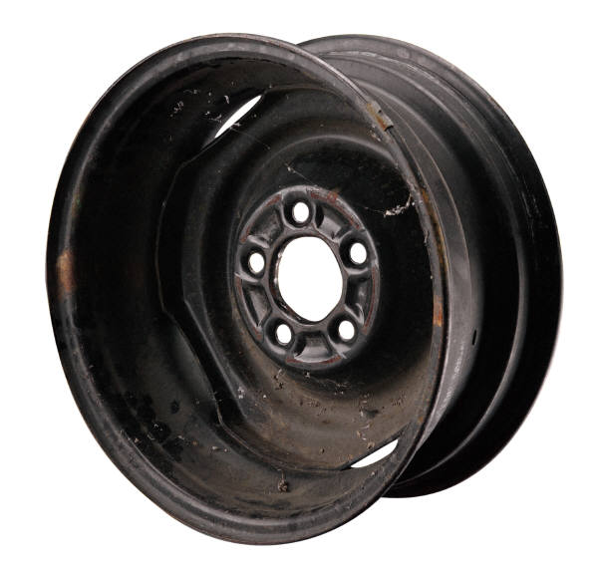
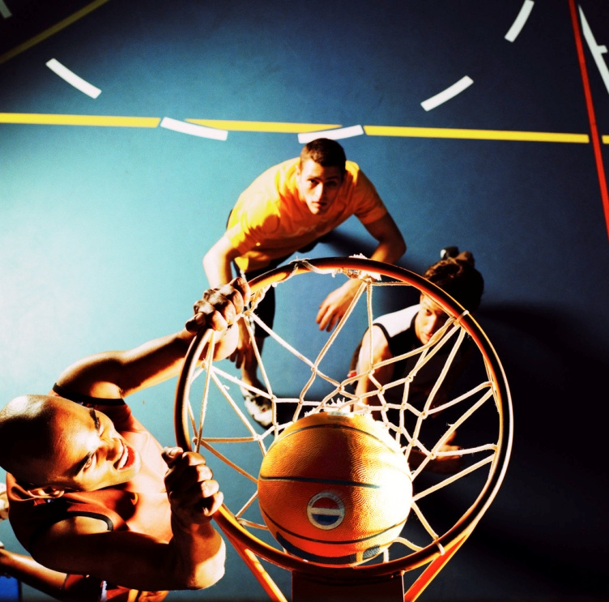
fouled
hoop
jersey
marveled
rim
speechless
swatted
unbelievable
rim
An edge, border, or margin on or around anything

Slide 8

fouled
hoop
jersey
marveled
rim
speechless
swatted
unbelievable
unbelievable
Incredible; hard to think of as true or real

Slide 9


fouled
hoop
jersey
marveled
rim
speechless
swatted
unbelievable
speechless
not able to talk

Slide 10
fouled
hoop
jersey
marveled
rim
speechless
swatted
unbelievable
swatted
hit sharply or violently

Slide 11
Give your teacher a thumbs up if the scenario fits with the word and a thumbs down if it does not.

Slide 12

unbelievable
- Susan went to the grocery store.

Slide 13

swatted
- The defending player knocked the ball away with a loud bang.

Slide 14
speechless
- I was so amazed I couldn’t think of words to say.

Slide 15
rim
- Isaac eats the outer edge of his sandwich before anything else.

Slide 16
marveled
- The group talked about how extraordinary it was to make this discovery.

Slide 17
jersey
- The police officer’s uniform was new.

Slide 18
hoop
- Eric stood on the bleachers.

Slide 19
fouled
- One player from the other team pushed Logan while he was shooting.

Slide 20
Which means the same thing as the underlined word?
Silas had a good view of the rim.
edge
outline

Slide 21
Which means the same thing as the underlined word?
The sisters marveled at how the beautiful flowers got there.
Were filled with joy
Were filled with wonder

Slide 22
Which means the same thing as the underlined word?
Josalyn is good with a hoop.
peg
ring

Slide 23
Which means the same thing as the underlined word?
The lady swatted the fly.
gripped
slapped

Slide 24
Which means the same thing as the underlined word?
Chad fouled during the soccer game.
left the field
broke a rule

Slide 25
Which means the same thing as the underlined word?
Michael left his jersey.
costume
shirt

Slide 26
Which means the same thing as the underlined word?
Summer’s performance left me speechless.
relieved
amazed

Slide 27
You’ve got it!

