Slide 1
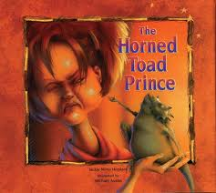
The Horned Toad Prince
Fourth Grade
Unit 1 Week 4

Slide 2
Words to Know
lassoed
prairie
offended
favor
riverbed
shrieked
bargain

Slide 3
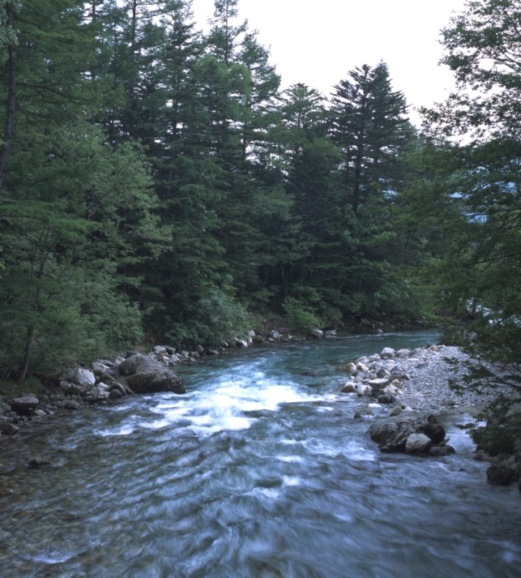
riverbed
prairie
favor
riverbed
bargain
lassoed
offended
shrieked
a channel in which a river flows or used to flow

Slide 4
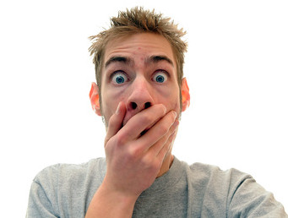
offended
prairie
favor
riverbed
bargain
lassoed
offended
shrieked
hurt feelings of someone; made angry, displeased, or pained

Slide 5
prairie
favor
riverbed
bargain
lassoed
offended
shrieked
bargain
a deal or an agreement to trade or exchange

Slide 6
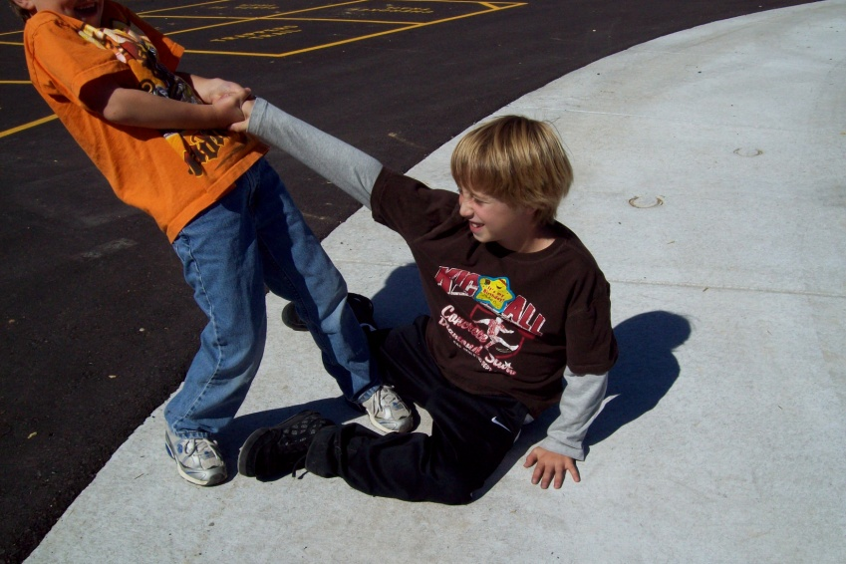
prairie
favor
riverbed
bargain
lassoed
offended
shrieked
favor
an act of kindness

Slide 7
prairie
favor
riverbed
bargain
lassoed
offended
shrieked
shrieked
made a loud, sharp, shrill sound

Slide 8
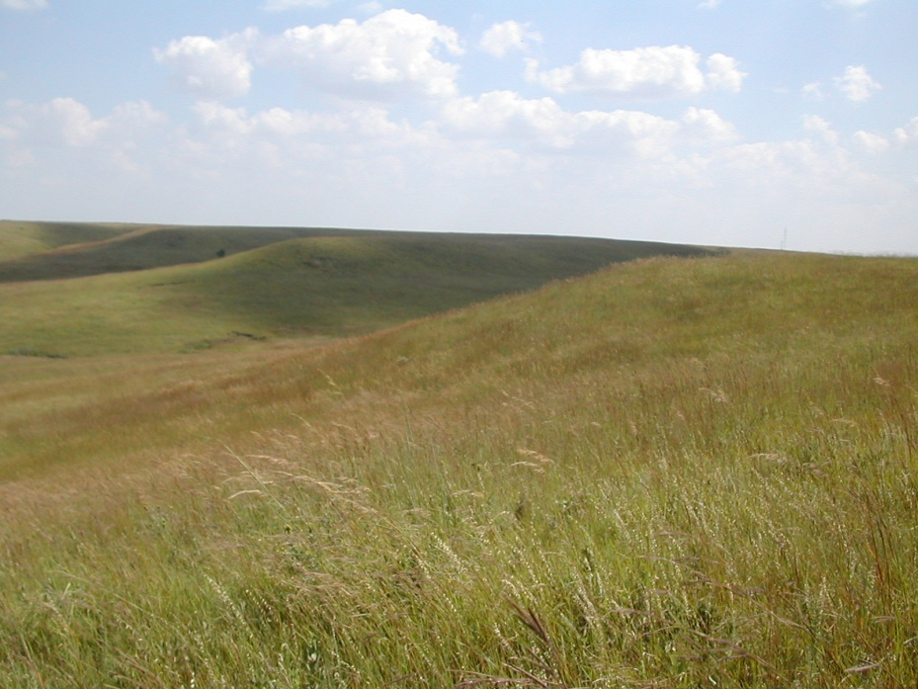
badger
bank
bristled
jointed
patched
ruffled
rushes
prairie
a large area of level or rolling land with grass but few or no trees

Slide 9
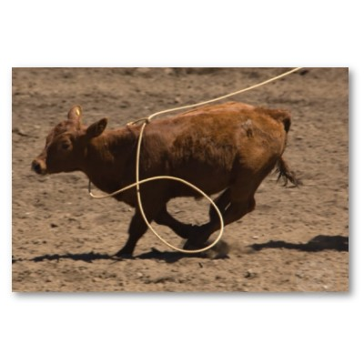
prairie
favor
riverbed
bargain
lassoed
offended
shrieked
lassoed
caught with a long rope with a loop on one end

Slide 10
Which means the same thing as the underlined word?
The boy lassoed the fencepost for practice.
caught with a long rope
knocked over

Slide 11
Which means the same thing as the underlined word?
The man is doing a favor for the woman by getting the book for her.
an act of kindness
a magic trick

Slide 12
Which means the same thing as the underlined word?
The woman made a bargain with the car dealer.
an opinion
a deal or agreement

Slide 13
Which means the same thing as the underlined word?
The view of the prairie seems peaceful and quiet.
large area of level or rolling land with grass and few or little trees.
seashore

Slide 14
Which means the same thing as the underlined word?
The woman shrieked because something frightened her.
make a loud, sharp, shrill sound
jumped

Slide 15
Which means the same thing as the underlined word?
The boy offended his classmates by talking on his phone during class.
made laugh
hurt the feelings of someone, made angry, or displeased

Slide 16
Which means the same thing as the underlined word?
This riverbed lies between steep mountains.
waterfall
a channel in which a river flows or used to flow

Slide 17
You’ve got it!

