Slide 1
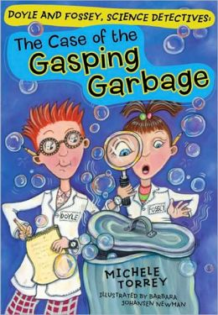
The Case of the Gasping Garbage
U4 W1 Presentation: Lesson Vocabulary, Word Analysis, Amazing Words, and Reading Comprehension

Slide 2
Lesson Vocabulary
analysis
noun (it is a thing)
Separation of anything into its parts or elements to find out what it is made of.
Does it look like she is scanning it quickly or carefully examining it?

Slide 3
Lesson Vocabulary
beakers
noun(it is a thing)
Thin glass or metal container with a flat bottom and a small lip for pouring that is used in laboratories.

Slide 4
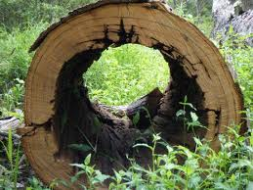
Lesson Vocabulary
hollow
adjective (a describing word)
Having nothing, only air, inside; with a hole inside. Not solid.
*Synonym: empty

Slide 5
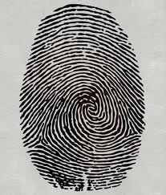
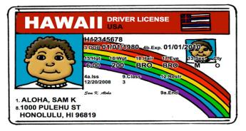
Lesson Vocabulary
identity
noun (it is a thing)
Who or what you are; what
something is.

Slide 6
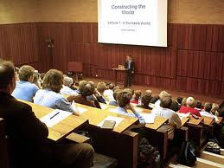
Lesson Vocabulary
lecture
noun (a thing)
A planned talk on a chosen subject before an audience; a speech.

Slide 7
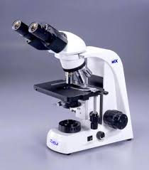
Lesson Vocabulary
microscope
noun (it’s a thing)
Device with a lens or combination of lenses for making small things look larger; often used to see bacteria, blood cells and other objects not visible to the naked eye

Slide 8
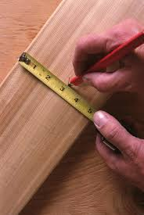
Lesson Vocabulary
precise
adjective (it describes something)
very definite or correct;
exact; accurate.

Slide 9
Lesson Vocabulary
relentless
adjective
Without giving up; not relenting; unyielding
If someone is relentless, are they going to stop doing it?

Slide 10
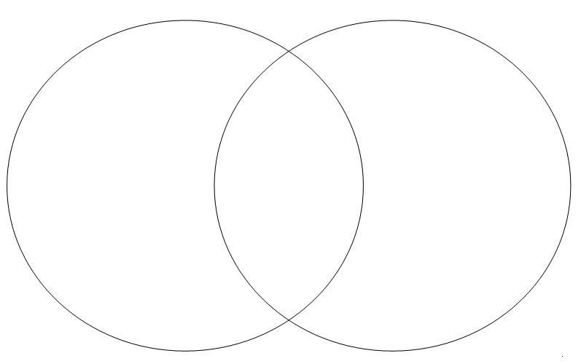
Skill and Strategy
Compare and Contrast:
*When you compare and contrast, you tell how two or more things are alike and different.
*You can compare and contrast two or more things you read about or compare something you read about with something that you already know.
*Use graphic organizers, like Venn Diagrams to help you compare and contrast.

Slide 11
Skill and Strategy
Visualize
*Good readers visualize as they read.
*Visualizing helps readers form mental pictures of what they are reading to help them understand ideas and information.
*Try to picture in your mind what the author has written to help the story come to life.

Slide 12
Word Analysis Suffixes: -ian, -ist, -ism
The Latin suffix –ian and the Greek suffixes –ist and –ism can be added to a word to change the meaning of the word.
-ist and -ian: one who__________
-ism: the act or process of doing something
Notes:
Write in Pink Guide Sheet

Slide 13
Word Analysis Let’s Practice!
*Choose a word from the first column and then choose a suffix and let’s see if we can figure out the meaning or the word.
WORDS
novel
magic
tour
violin
library
critic
environmental
history
SUFFIX
-ian
-ism
-ist

Slide 14
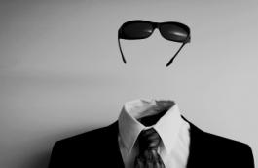
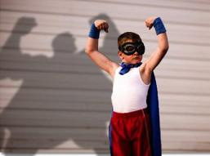
Amazing Words
invisible: adj
Unable to be seen, not visible to the eye
pretending: verb
To act as if something is true when not true

Slide 15
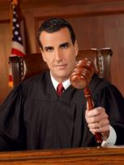
Amazing Words
fooled: noun
A person who lacks good sense or judgement
judge: verb
To form an opinion about someone or something after careful thought

Slide 16
The Case of the Gasping Garbage
U4 WK 1
Day 2: Word Analysis, Amazing Words

Slide 17
Word Analysis Let’s Practice!
novel+ist= novelist
What is a novelist?
A person who writes a novel.
magician+ian=magician
What is a magician?
A person who does magic.

Slide 18
Word Analysis Your turn!
Let’s determine the meaning of the words in each sentence.
After the presentation, a talented magician entertained us.
A: person who recites poetry
B: person skilled in magic
C: person who studies how magnets work
D: person who draws funny portraits
What does –ian mean in the underlined word?
-ian means one who____
The pianist played a beautiful song.
A: person who plays the piano
B: person who tunes a piano
C: person who makes a piano
D: person who listens to piano music
What does –ist mean in the underlined word?
-ist means one who____

Slide 19
Skill Let’s Remember
Compare and Contrast:
*When you compare and contrast, you tell how two or more things are alike and different.
*You can compare and contrast two or more things you read about or compare something you read about with something that you already know.
*Use graphic organizers, like Venn Diagrams to help you compare and contrast.

Slide 20
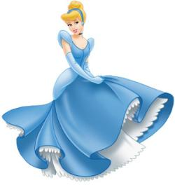
Skill and Strategy Now it is your turn!
Compare and Contrast:
How are these two characters alike?
How are they different?

Slide 21
Word Analysis Do you remember?
The naturalist was our tour guide through the park.
A: person who creates art on walls
B: person who organizes things
C: person who seems to know everything
D: person who studies nature
What is the meaning of –ist?
Kevin’s idealism helps him resist all temptations that come his way.
A: having high ideals
B: having original ideas
C: person who seems to know everything
D: person who studies nature
What is the meaning of -ism

Slide 22
Word Analysis Do you remember?
Taylor Swift is a famous Pennsylvanian.
A: person who admires Pennsylvania
B: person who has never been to Pennsylvania
C: person from Pennsylvania
D: person who hates Pennsylvania
What is the meaning of –ian?

Slide 23
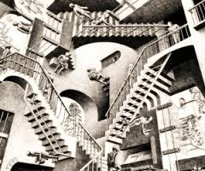
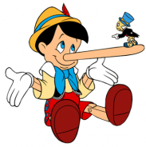
Amazing Words
deceiving: verb
To make someone believe something is not true
unthinkable: adj
impossible to imagine or believe

Slide 24
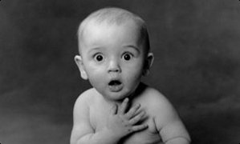
Amazing Words
astonished: verb
to cause a feeling of great wonder or surprise in someone
illusion: noun
something that looks or seems different from what it is

Slide 25
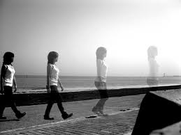
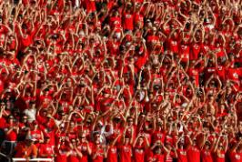
Amazing Words
disappeared: verb
to stop being visible
spectators: noun
person who watches an event, show, game, or activity, part of an audience

